Slide 1
A Case Study
CSE-478 (Fall 2011)
Source: Managing Software Requirements
by Leffingwel and Widrig

Slide 2
Key Points
Preliminary User Needs
Problem Statements for Stakeholders
System and Actors
Constraints

Slide 3
Home Lighting Automation System (HOLIS)
Home Lighting Automation System
  Lumenations, a supplier of commercial lighting system, is a public company.
  Lack of growth in sales is taking its toll on the company and its stakeholders.
  Whats needed is a new marketplace, in its working domain, with a potential opportunity for growth in revenue and profits.
  After thorough market research and based on the opinion of marketing consultants, the company has decided to enter a market of lighting automation for residential systems.
  Holis (Home Lighting Automation System) is to be marketed by Lumenations.

Slide 4
Preliminary User Needs
The system will need to support programmable key switches to activate the lighting features in various rooms.
Homeowners need a means to choose system options using a central control.
Other prospective buyers have requested that the system be programmable and they should be able to do all of the installation, programming and maintenance themselves.
Some others require a simple push button control panel interface.
The system should also have an emergency contact facility too.

Slide 5
Problem Statement – Format
Element | Description
The problem
Affects
Result s
Benefits of the proposed solution

Slide 6
Problem Statement – For Lumenations
Element | Description
The problem | Slowing growth of revenue in the company
Affects | The company; its employees, and its shareholders
Result s | Slowing business performance and lack of opportunities in profitability.
Benefits of the proposed solution | Revitalizing the company and its employees Increased loyalty and retention of the company’s distributors Higher revenue growth and profitability Increase in company’s stock price.

Slide 7
Problem Statement – For Homeowners
Element | Description
The problem | Lack of product choices, limited functionality and high cost of home lighting automation systems
Affects | The homeowners of residential systems
Result | Unacceptable performance of purchased system, or decide “not to automate”
Benefits of the proposed solution | Higher homeowner satisfaction Increased flexibility and usability of residence Improved safety, comfort and convenience

Slide 8
Problem Statement – For Distributors
Element | Description
The problem | Lack of product choices, limited functionality, and high cost of existing home lighting system
Affects | Distributors and builders of residential systems
Result s | Few or no opportunities for higher marketing products
Benefits of the proposed solution | Higher revenues and profitability Increased market share

Slide 9


System with Actors
Lights etc.
Homeowner
HOLIS
Emergency Receiver
Lumenations Services

Slide 10
System with Actors
The homeowner who uses the system to control the lighting
The various lights that the system, in turn, controls
Lumenations Services, the manufacturer that can remotely program the system
Emergency receiver, who will receive emergency messages

Slide 11
Non-actor stakeholders
Name | Comments
External Distributors | Lumenations direct customer
Builders | General contractors responsible to the homeowners for the end result
Electrical contractors | Responsible for installation and support
Product manager | Marketing/product management team

Slide 12

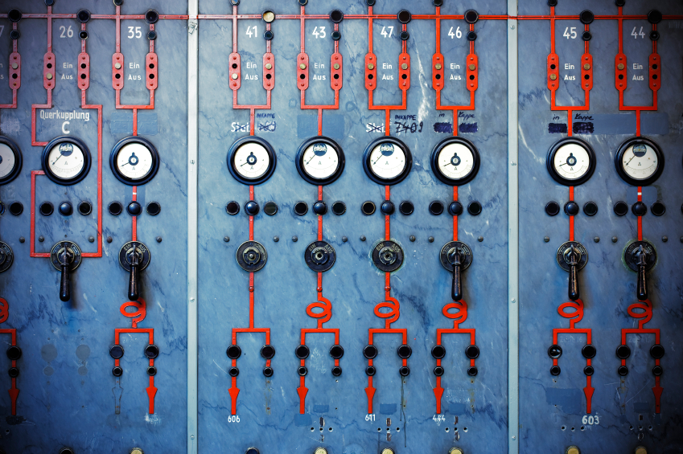

The Subsystems
HOLIS
Central Control
Unit
Control Switch
Homeowner
Lights etc.
PC Programmer
Emergency Receiver
Lumenations Services

Slide 13
The Subsystems
From the system perspective, Central Control Unit (CCU) acts as the brain of the system
Homeowner
Central Control
Unit
Lights etc.
Control Switch
Emergency Receiver
Lumenations Services
PC Programmer

Slide 14
Constraints of the system
Description | Rationale
The team would adopt UML model, OO-based methodologies | These technologies will provide increased productivity and robustness
The software would be written in C++. Assembly language would be used for control switch | For consistency and maintainability, the team knows these languages
A prototype system must be ready within 2 months | To take distributors’ orders
Benefits of the proposed solution | Higher revenues and profitability Increased market share

Slide 15
Constraints of the system – Contd…
Description | Rationale
The microprocessor subsystem for CCU would be taken from Advanced Lighting System Project (ALSP) | These technologies will provide increased productivity and robustness
The Homeowner PC configuration would be compatible with Windows-7 | Scope management for release 1.0
Two full time employees would be hired with necessary skills | Allowable budget expansion
The single chip processor would be used in the control switch | Already in use in the company

